Slide 1
Object Oriented Software Engineering (OOSE)
22CS017
Introduction to Building Analysis Model

Slide 2
Index
What is Requirement Analysis
Specification Guidelines
Introduction to Domain Analysis
What is Data Modelling
Define Object Oriented Concepts
Process
Flow Modelling
Control Model

Slide 3
Requirements Analysis
Requirements analysis
  specifies software’s operational characteristics
  indicates software's interface with other system elements
  establishes constraints that software must meet
Requirements analysis allows the software engineer (called an analyst or modeler in this role) to:
  elaborate on basic requirements established during earlier requirement engineering tasks
  build models that depict user scenarios, functional activities, problem classes and their relationships, system and class behavior, and the flow of data as it is transformed.
What is the product from Requirements Analysis?

Slide 4
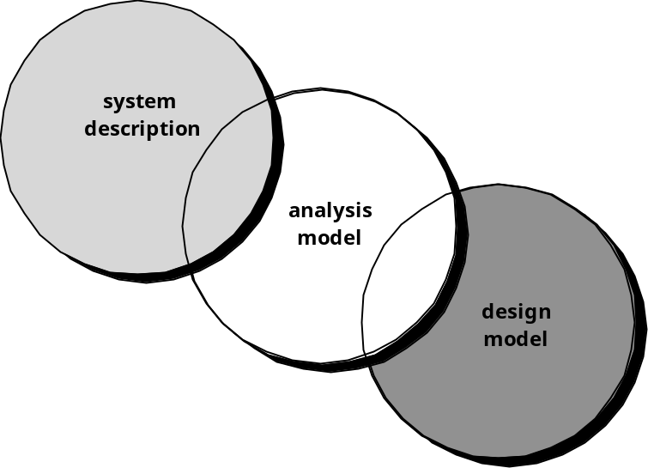
A Bridge
Writing the Software Specification
Everyone knew exactly what had to be done until someone wrote it down!
Figure 1: Writing the Software Specification

Slide 5
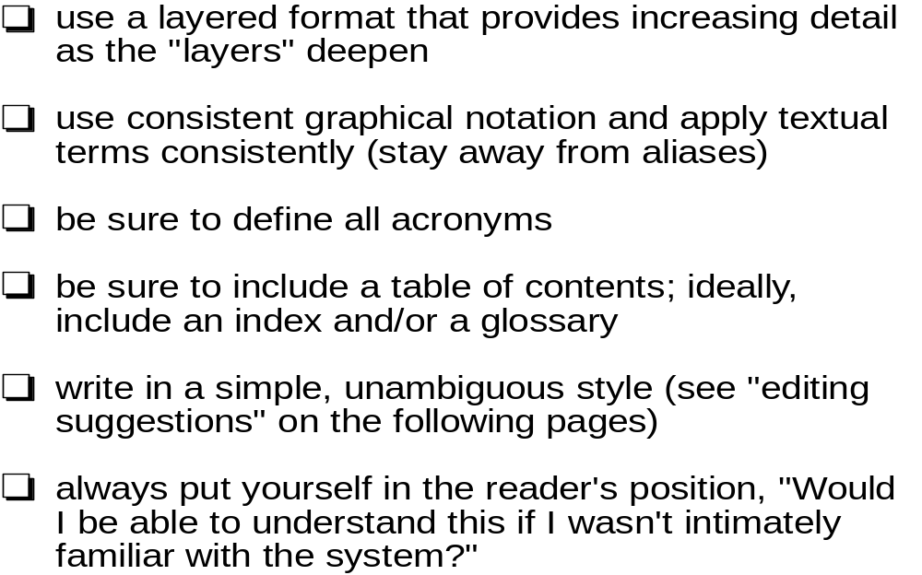
Specification Guidelines

Slide 6
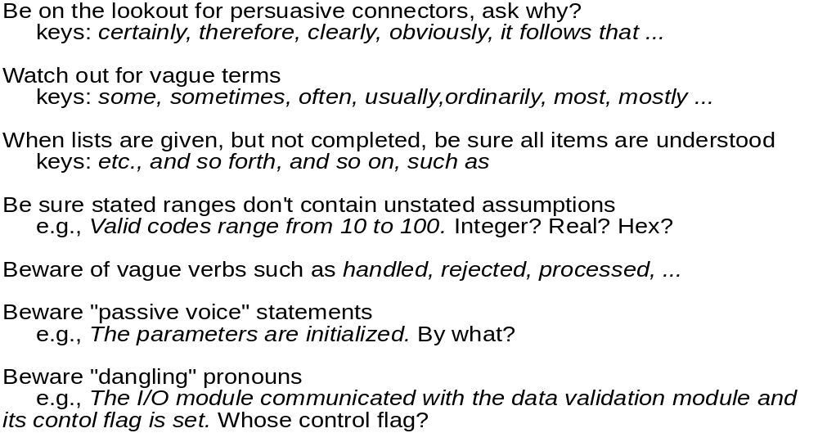
Specification Guidelines

Slide 7
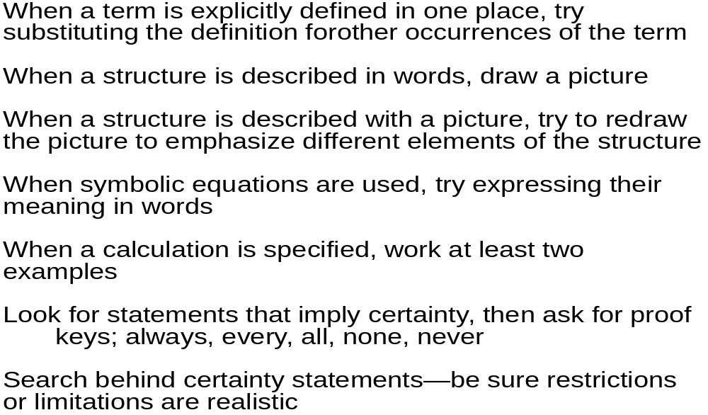
Specification Guidelines

Slide 8
Domain Analysis
Define the domain to be investigated.
Collect a representative sample of applications in the domain.
Analyze each application in the sample.
Develop an analysis model for the objects.
In terms of data modeling, function/process modeling, behavioral modeling, etc.
Is this needed also for System Engineering, or for Requirements Analysis only?

Slide 9
Data Modeling
examines data objects independently of processing
focuses attention on the data domain
creates a model at the customer’s level of abstraction
indicates how data objects relate to one another

Slide 10
What is a Data Object?
Object
—something that is described by a set
of attributes (data items) and that will be
manipulated within the software (system)
object: automobile
attributes:
make
model
body type
price
options code
each
instance
of an object (e.g., a book)
can be identified uniquely (e.g., ISBN #)
each plays a necessary role in the system
i.e., the system could not function without
access to instances of the object
each is described by attributes that are
themselves data items

Slide 11
What is a Relationship?
Relationship:- indicates “connected”; a “fact” that must be “remembered” by the system and cannot or is not computed or derived mechanically
several instances of a relationship can exist
objects can be related in many different ways

Slide 12
ERD Notation
One common form:
(0, m)
object
relationship
object
1
(1, 1)
2
attribute
Another common form:
object
relationship
object
1
2
(0, m)
(1, 1)
Figure 2: ERD Model

Slide 13
The ERD: An Example
request
for service
Customer
places
(1,1)
(1,m)
(1,1)
standard
task table
generates
(1,n)
work
order
(1,1)
(1,1)
(1,1)
selected
from
work
tasks
(1,w)
consists
of
(1,w)
(1,i)
materials
lists
Figure 3: Example

Slide 14
Object-Oriented Concepts
Key concepts:
  Classes and objects
  Attributes and operations
  Encapsulation and instantiation
  Inheritance
How is this different from ERD?

Slide 15
Classes
object-oriented thinking begins with the definition of a class, often defined as:
  template, generalized description, “blueprint” ... describing a collection of similar items
a metaclass (also called a superclass) establishes a hierarchy of classes
once a class of items is defined, a specific instance of the class can be identified
metaclass = superclass?

Slide 16
What is a Class?
occurrences
roles
things
organizational units
places
external entities
structures
external entities (printer, user, sensor)
class name
things
(e.g, reports, displays, signals)
attributes:
occurrences or events (e.g., interrupt, alarm)
roles
(e.g., manager, engineer, salesperson)
organizational units
(e.g., division, team)
operations:
places
(e.g., manufacturing floor)
structures (e.g., employee record)
Figure 4: Class

Slide 17
Encapsulation/Hiding
The object encapsulates both data and the logical procedures required to manipulate the data
method
# 1
method
# 2
data
method
# 3
method
# 6
Achieves “information hiding”
method
# 5
method
# 4
A method is invoked via message passing.
An executable procedure that is encapsulated in a class and is designed to operate on one or more data attributes that are defined as part of the class.
Figure 5: Encapsulation

Slide 18
Class Hierarchy
PieceOfFurniture (superclass)
Table
Chair
Desk
”Chable"
subclasses of the
instances of Chair
Figure 6: Class Hierarchy

Slide 19
Flow-Oriented Modeling
Represents how data objects are transformed at they move through the system
A data flow diagram (DFD) is the diagrammatic form that is used
Considered by many to be an ‘old school’ approach, flow-oriented modeling continues to provide a view of the system that is unique—it should be used to supplement other analysis model elements
computer
based
system
input
output
Figure 7: Flow Oriented Modelling

Slide 20
Flow Modeling Notation
external entity
process
data flow
data store
Figure 8: Flow Modelling Notations

Slide 21
External Entity
A producer or consumer of data
Examples: a person, a device, a sensor
Another example: computer-based
system
Data must always originate somewhere
and must always be sent to something

Slide 22
Process
A data transformer (changes input
to output)
Examples: compute taxes, determine area,
format report, display graph
Data must always be processed in some
way to achieve system function

Slide 23
Data Flow
Data flows through a system, beginning
as input and be transformed into output.
base
compute
triangle
area
area
height
Figure 9: Data Flow

Slide 24
Data Stores
Data is often stored for later use.
sensor #
sensor #, type,
location, age
look-up
sensor
data
report required
type,
location, age
sensor number
sensor data
Figure 10: Data Stores

Slide 25
Data Flow Diagramming:
Guidelines
all icons must be labeled with meaningful names
the DFD evolves through a number of levels of detail
always begin with a context level diagram (also called level 0)
always show external entities at level 0
always label data flow arrows
do not represent procedural logic

Slide 26
Constructing a DFD—I
review the data model to isolate data objects and use a grammatical parse to determine “operations”
determine external entities (producers and consumers of data)
create a level 0 DFD

Slide 27
Level 0 DFD Example
processing
request
user
requested
video
signal
digital
video
processor
monitor
video
source
NTSC
video signal
Figure 11: Level 0 DFD

Slide 28
Constructing a DFD—II
write a narrative describing the transform
parse to determine next level transforms
“balance” the flow to maintain data flow continuity
develop a level 1 DFD
use a 1:5 (approx.) expansion ratio

Slide 29
The Data Flow Hierarchy
a
b
x
P
y
level 0
a
c
p2
f
p1
p4
b
d
5
p3
e
g
level 1
Any correspondence with a use case diagram?
Figure 12: Data Flow Hierarchy

Slide 30
Flow Modeling
each bubble is refined until it does just one thing
the expansion ratio decreases as the number of levels increase
most systems require between 3 and 7 levels for an adequate flow model
a single data flow item (arrow) may be expanded as levels increase (data dictionary provides information)

Slide 31
Process Specification (PSPEC)
bubble
PSPEC
narrative
pseudocode (PDL)
equations
tables
diagrams and/or charts
Figure 13: Process Specification

Slide 32
DFDs: A Look Ahead
analysis model
Maps into
design model
Figure 14: DFDs

Slide 33
Control Flow Diagrams
Represents “events” and the processes that manage events
An “event” is a Boolean condition that can be ascertained by:
    listing all sensors that are "read" by the software.
    listing all interrupt conditions.
    listing all "switches" that are actuated by an operator.
    listing all data conditions.
    recalling the noun/verb parse that was applied to the processing narrative, review all "control items" as possible CSPEC inputs/outputs.

Slide 34
The Control Model
the control flow diagram is "superimposed" on the DFD
and shows events that control the processes noted in
the DFD
control flows—events and control items—are noted by
dashed arrows
a vertical bar implies an input to or output from a control
spec (CSPEC) — a separate specification that
describes how control is handled
a dashed arrow entering a vertical bar is an input to the
CSPEC
a dashed arrow leaving a process implies a data
condition
a dashed arrow entering a process implies a control
input read directly by the process
control flows do not physically activate/deactivate the
processes—this is done via the CSPEC

Slide 35
Control Flow Diagram
beeper on/off
copies done
full
manage
copying
read
operator
input
start
problem light
reload
process
empty
create
user
displays
perform
problem
diagnosis
jammed
display panel enabled
Figure 15: Control Flow Diagram

Slide 36
Control Specification (CSPEC)
The CSPEC can be:
state diagram
(sequential spec)
state transition table
combinatorial spec
decision tables
activation tables

Slide 37
Guidelines for Building a CSPEC
list all sensors that are "read" by the software
list all interrupt conditions
list all "switches" that are actuated by the operator
list all data conditions
recalling the noun-verb parse that was applied to the
software statement of scope, review all "control items"
as possible CSPEC inputs/outputs
describe the behavior of a system by identifying its
states; identify how each state is reach and defines
the transitions between states
focus on possible omissions ... a very common error in
specifying control, e.g., ask: "Is there any other way I
can get to this state or exit from it?"

Slide 38
Practice Questions
Apply the concepts and notations to draw a Class Diagram for an Automated Teller Machine case study
Explain
1.Class Diagram 2.Object Diagram
3. Define
1.Generlization 2.Association 3.Relation 4. Dependency 5. Package 6. Realization 7. Aggregation
3. Define Structured Analysis vs. Object Oriented Analysis
4. Under what conditions would you decompose a process on a Data-Flow Diagram?
5. What are some of the specific benefits of Data Flow Models?

Slide 39
THANKS

